Slide 1



Forest Fire Detection Using Deep learning
Student name : Fariha Naaz
AICTE Student ID : STU6640e58ce9eea1715529100

Slide 2

Learning Objectives
To understand the working of Convolutional Neural Networks (CNNs) for image-based fire detection.
Learn how convolutional layers, pooling, and activation functions contribute to feature extraction.
Explore and implement deep learning models using TensorFlow and Keras.
Apply effective image preprocessing and augmentation techniques to prepare the dataset.
Analyze the model’s accuracy, loss, and confusion matrix to evaluate performance.
GOAL

Slide 3
Tool and Technology used
Python - Primary programming language for model development.
TensorFlow & Keras – For building, training, and evaluating the CNN model.
OpenCV – Used for image processing and data augmentation.
NumPy & Pandas – For data handling and preprocessing tasks.
Matplotlib & Seaborn – To visualize training metrics and confusion matrices.
Scikit-learn – For evaluating model performance using standard metrics.
Google Colab / Jupyter Notebook – Interactive environments for development and testing.
Kaggle – Source of the wildfire image dataset and research ideas.

Slide 4
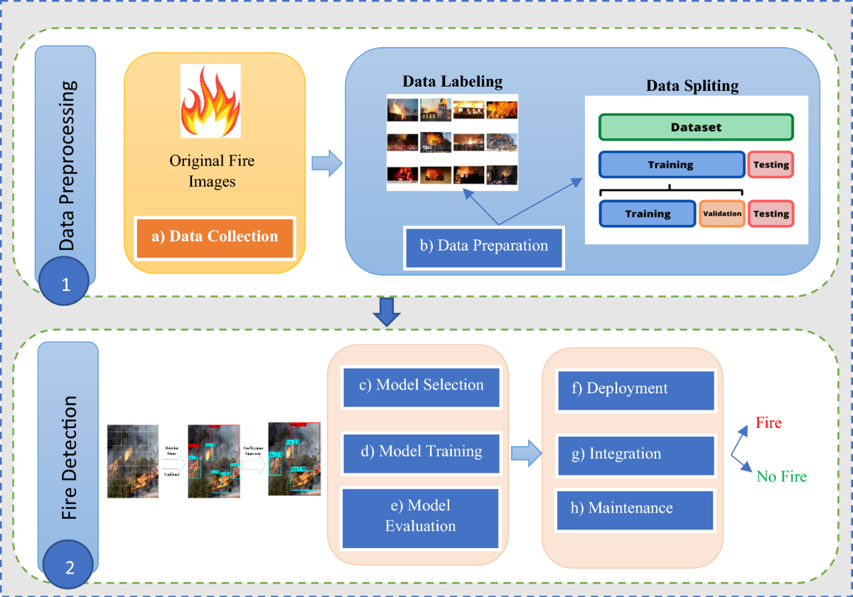
Methodology
Data preprocessing
Data Augmentation
Modeling(Design CNN)
Training
Validation
fire
Testing
Prediction
nofire

Slide 5
Problem Statement:
Wildfires present a critical risk to ecosystems, wildlife, and human safety due to their rapid and often unpredictable spread. Early detection is essential for effective response and mitigation. This project aims to develop an intelligent deep learning-based system capable of automatically detecting forest fires from images. The system will accurately differentiate between fire and non-fire scenarios across diverse forest environments and varying fire conditions, addressing challenges such as false positives and missed detections. The objective is to enable timely alerts, thereby enhancing wildfire prevention and response efforts.

Slide 6
Solution:
To address the challenge of early forest fire detection, a Deep Learning-based image classification approach was implemented using a Convolutional Neural Network (CNN). The model was trained on the Wildfire Dataset from Kaggle, which contains labeled images of fire and non-fire scenarios. The CNN architecture consists of convolutional layers for extracting visual features, pooling layers to reduce dimensionality, dropout layers to prevent overfitting, and dense layers for final classification. This design allows the model to accurately classify and generalize fire detection across different forest regions. The model achieved an accuracy of approximately 81.77% on unseen data. Once deployed, it can be effectively used in real-time applications such as video surveillance, drone-based forest monitoring, and mobile alert systems, significantly enhancing the speed and reliability of wildfire response efforts.
Github Link : https://github.com/FarihaNaaz20/Forest-Fire-Detection

Slide 7
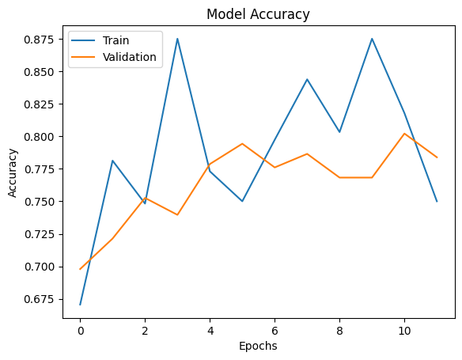
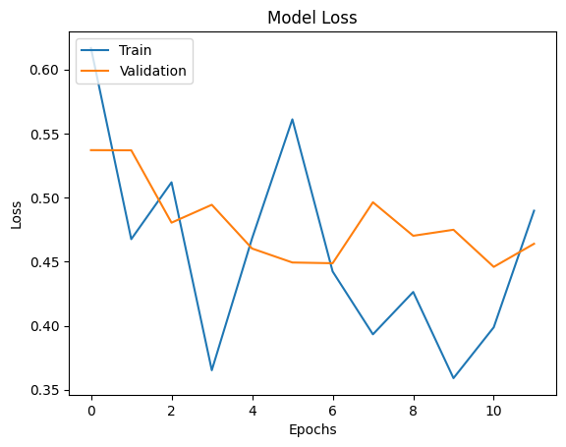
Screenshot of Output:
Fig 1 : Graph : Model Accuracy and Loss

Slide 8
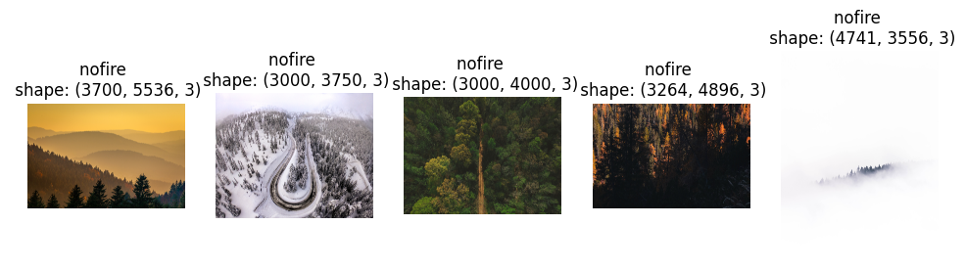
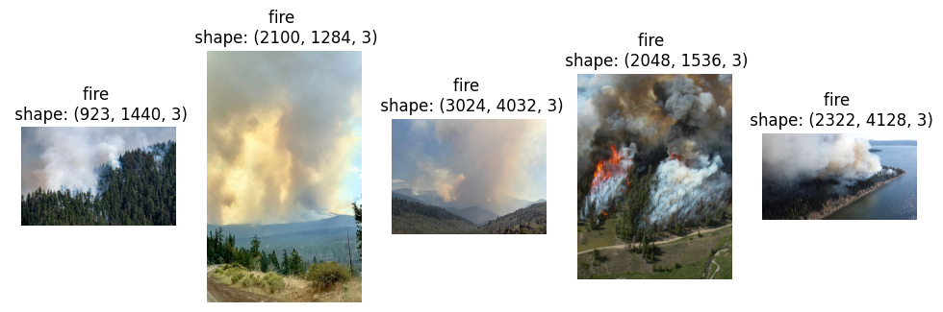
Fig 2 : Training data image into two classes nofire and fire

Slide 9
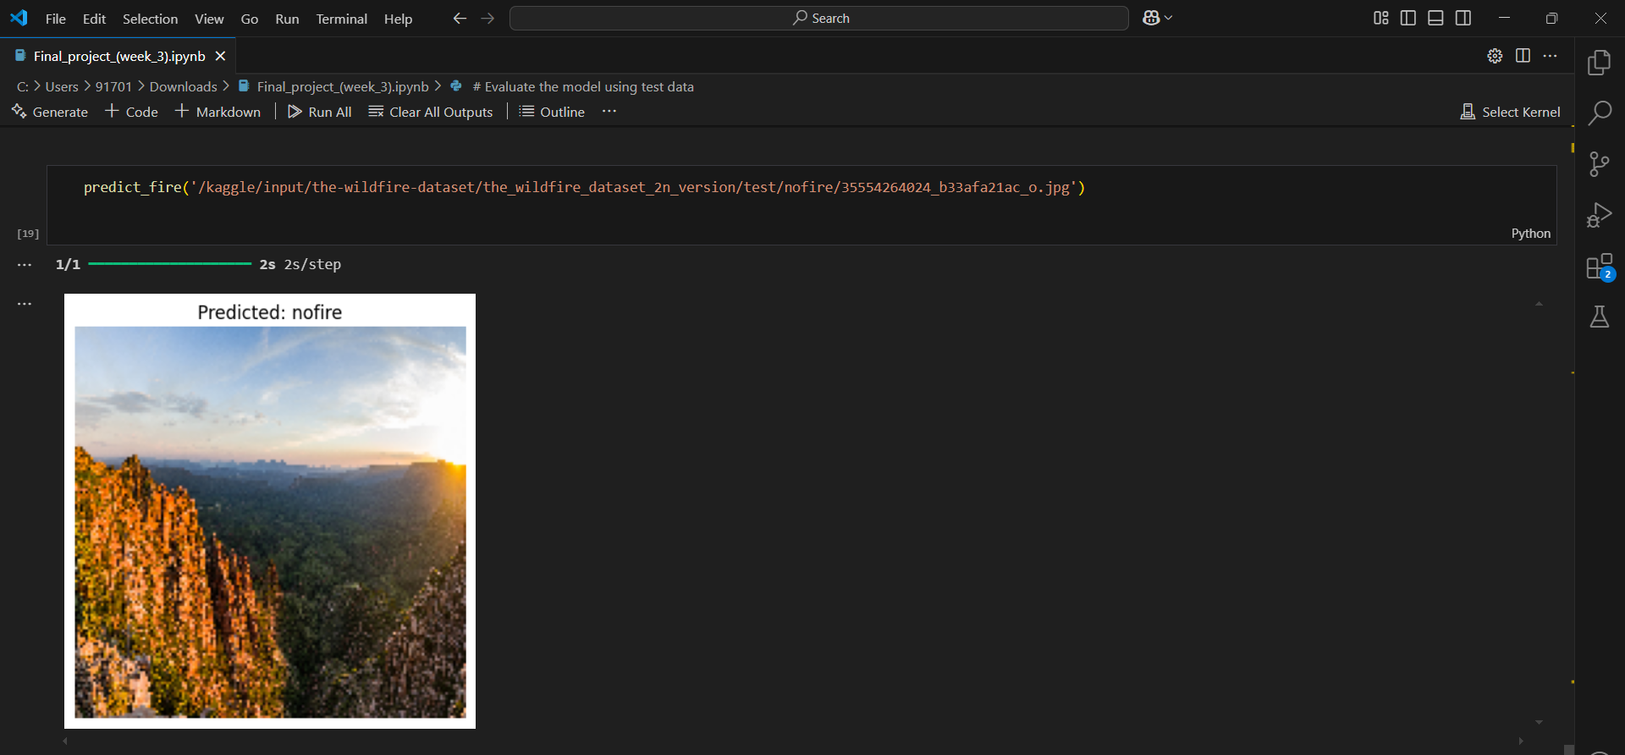
Fig 3 : CNN Model Prediction Output Showing 'No Fire' for Forest Image

Slide 10
Conclusion:
This project demonstrated the effective application of deep learning in addressing real-world environmental issues, specifically wildfire detection. By developing a Convolutional Neural Network (CNN) trained on a specialized image dataset, I was able to accurately classify images as fire or no-fire. Beyond the technical aspects, this experience highlighted the importance of early wildfire detection in protecting lives and ecosystems. The promising performance of the model opens avenues for future enhancements such as real-time video monitoring, web-based deployment, and integration with drone or IoT systems. Overall, this project not only enriched my technical skills but also strengthened my conviction in leveraging AI for social and environmental good.

